Slide 1











ATM Neighborhood
NCR Cash Remittance Web Portal
Which WAY is your customer satisfaction heading?

Slide 2







Today’s Agenda
1
Introduction
Functionality
2

Slide 3
Introduction
The web portal application is developed to aid the Cash Remittance System through:
  Reports.
  Maintenance.
  Registration.
  Of course any web application contains the administrator panel which is used to configure the application settings, add users and add groups.
Each of the above subsystems helps in taking critical decisions and controlling the transaction flow.
Each of the above subsystems will be discussed in details below.

Slide 4

Today’s Agenda
1
Introduction
2
Functionality

Slide 5
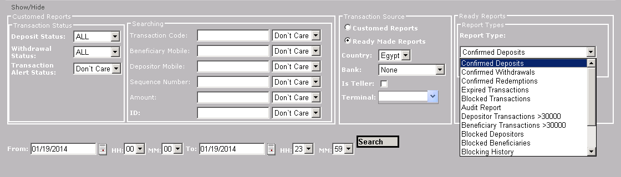
Cash Remittance Web Portal
  Reports: The Reports application offers many reports to help in taking critical decision and how the Cash Remittance system works.
  There are 2 type of reports:
  Read made reports.
  Costumed Reports.

Slide 6
Cash Remittance Web Portal
Ready Made reports are:
Confirmed Deposits
Confirmed Withdrawals
Confirmed Redemptions
Expired Transactions
Blocked Transactions
Audit Report
Depositor transactions > 30000
Beneficiary transactions > 30000
Blocked Depositors
Blocked Beneficiaries
Blocking History
Transactions with invalid trials
Cash Remittance users
Cash Remittance Terminals
Statistical

Slide 7
Cash Remittance Web Portal
As you can see there are a lot of filters that can be used while searching for a transaction.

Slide 8
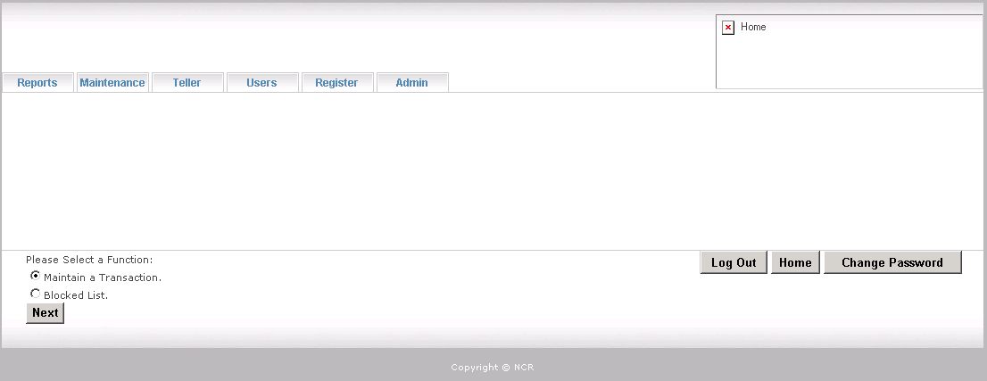
Cash Remittance Web Portal
  Maintenance Application
  Here there are 2 options:
  Maintenance of a transaction
    This where all controls that can be applied on a transaction
  Blocked list
    This where you can block any customer through entering his mobile number.

Slide 9
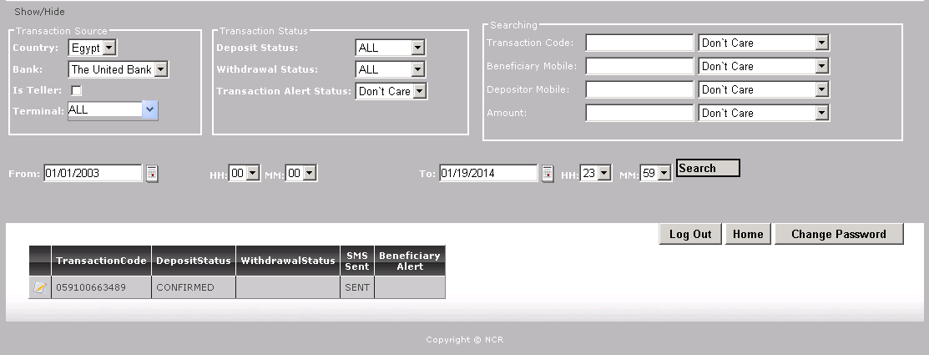
Cash Remittance Web Portal
  Maintenance Application:
    As you can see there are filters that can used to narrow your search.

Slide 10
Cash Remittance Web Portal
  Maintenance Application: this application is used to control the transactions, where you can:
      Hold, Un-Hold.
        This function can be used to reserve the transaction without counting the expiry days till Un-Hold Button is pressed.
      Activate.
        If the transaction is expired this function is used to activate it so that it can be withdrawn again.
      Unblock.
        While withdrawing if there is an uncertain dispense, this function used after investigation to decide whether the transaction is withdrawn or not.
      Resend SMS.
        If the SMS Gateway did not send the SMS to either the depositor or the beneficiary, this function is used to send it.
      Expire Transaction.
        Use this function to manually expire a transaction.
      Reset key Trials.
        Use this function when the Beneficiary reaches the maximum trials of withdrawing the transaction, use this function to reset the key trials.

Slide 11
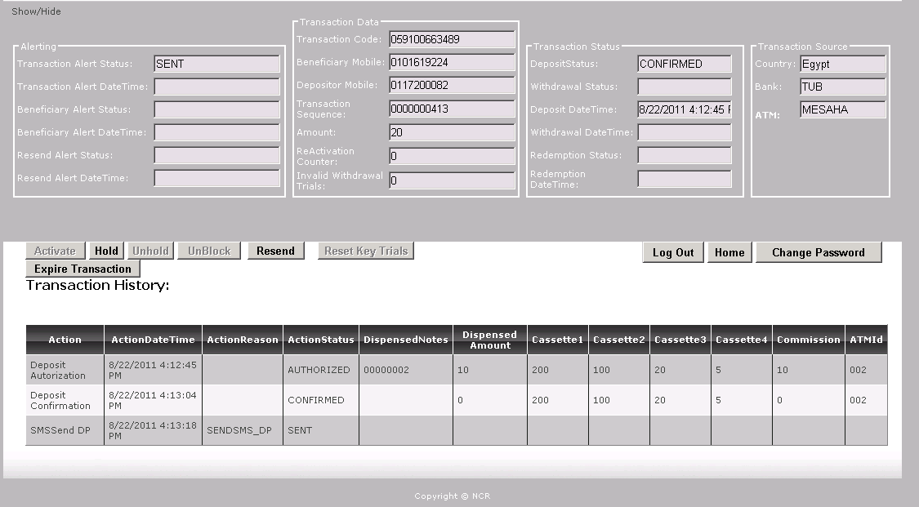
Cash Remittance Web Portal
  The history of the transaction is listed below in the table, and the possible actions that can be applied on the transaction.

Slide 12
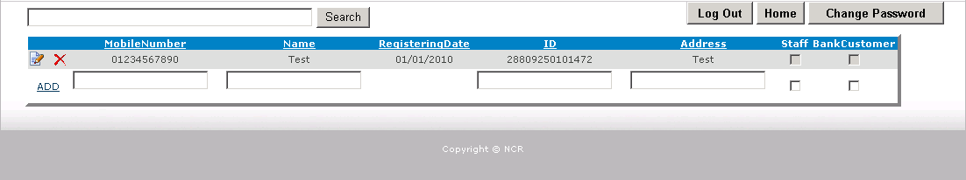
Cash Remittance Web Portal
  Registration:
  Use the below form to add the customers so that they can use the remittance service, the mandatory fields are:
  Mobile Number.
  Valid ID number(The id number is validated against an equation provided from the ministry of interior).

Slide 13


Thank You!!
Scale and
Geographical
Reach
Transforming your customer interactions into amazing experiences
Partnering
Resources
Disruptive
Technologies
Radical
Thinking
Unique
Consumer
Insight

